Slide 1
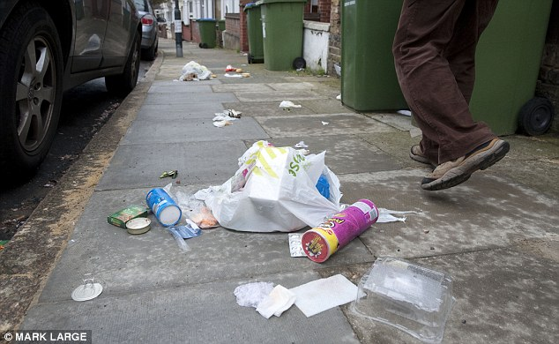
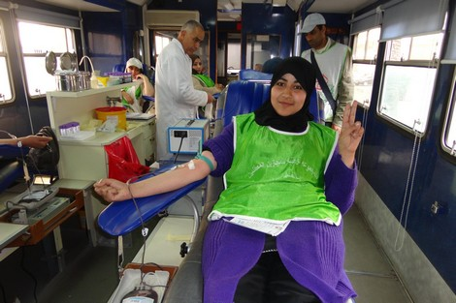
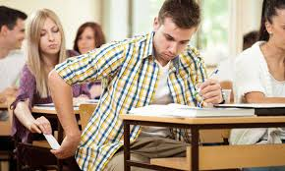
Discuss the difference
Takes notes before starting discussion
Citezenship
MoroccoEnglish.com - By M. ELKADAOUI
Vs.

Slide 2
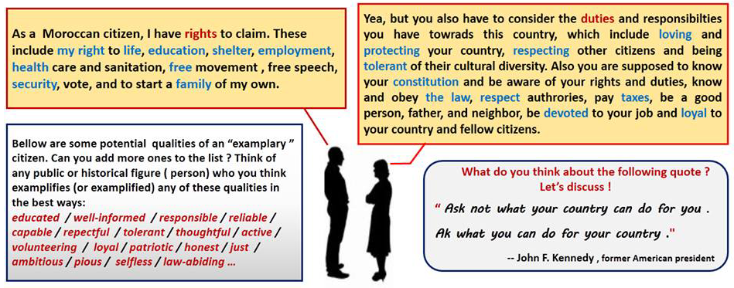

Slide 3
Exercise : Choose the right words to complete the sentences: vote – involvement- elections – responsibilities -rights – improvement -patriotism- community – active - duties
Good citizens would participate in ……………………….by choosing the candidate they feel they can ………………………. for.
Citizens have ………………………but they must also be aware of their ……………………….. towards their community.
Good citizens must work for the prosperity of the ………………………………they live in.
Civic engagement is the positive …………………………..in the affairs of the community.
Love of and devotion to one's country is called ……………………………
An ……………………………. citizen is involved in the …………………………… of the community
elections
vote
rights
responsibilities
community
involvement
patriotism
active
improvment

Slide 5
to have a job
to have access to health care
to tell the truth
to respect the flag of your country
to be safe
to be respected
to have access to education
to respect the rules and laws
to pay taxes
to earn your livelihood
to have somewhere to live
to vote
to have access to leisure facilities
to be tolerant
to respect the environment
to be concerned for the common good
To be free to express your opinion
To join community service
Rights | Responsibilities
To have a job
To have access to health care
to be safe
To be respected
to have access to education
to earn your livelihood
to have somewhere to live
to have access to leisure facilities
To be free to express your opinion
To join the community service
To tell the truth
To respect the flag of your country
To respect rules and laws
To pay taxes
To vote
To be tolerant
To respect the environment
To be concerned for the common good

