Slide 1
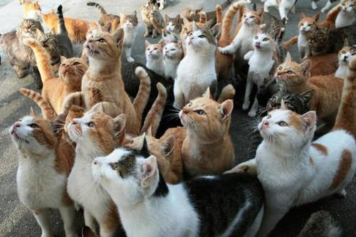
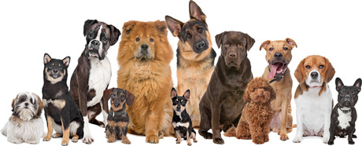
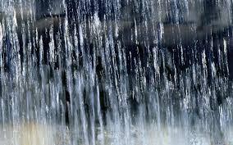
Idioms
M. ELKADAOUI
vocabulary
It is raining
Cats
dogs
Understanding the sentence word by word!!!
It’s raining cats and dogs .
After joining the words in a group. Their meaning becomes different.

Slide 2
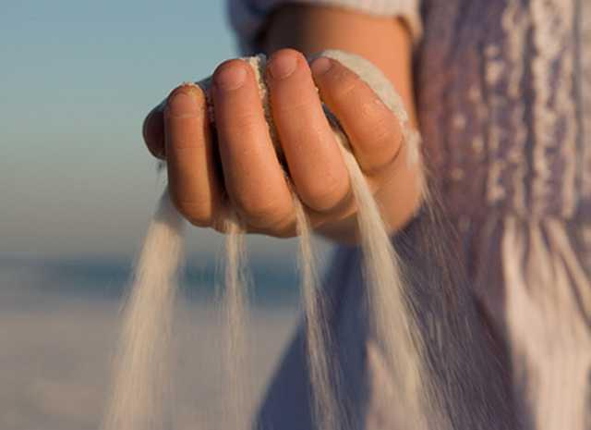
The sand slips through her fingers.
The opportunities slip through her fingers.
الفرص تتسرب بين الاصبع – الترجمة الحرفية
She doesn’t seize the opportunities.
the opportunities slip through your fingers
To be successful, you should not let …………………………………….

Slide 3
idioms
vocabulary
What do the words in red mean?
A quick way Be quick Come Watch
1. My friend and I take it in turns to cook.
(I cook one day, he cooks the other day)
2. I asked her to keep an eye on my suitcase while I went to the toilet.
(Watch)
3. I'm sorry I can't make it on Friday.
(Come)
4. It's not far. We can take a short cut through the park.
(A quick way)
5. The teacher told us to get a move on.
(Be quick)

Slide 4
Exercise: Select the right meaning for each idiom.
1. Tom and Sue were given valuable prizes by their parents because they passed their exams with flying colours.
They failed their exams.
They passed their exams successfully.
They coloured their certificates.
2. My son is good at languages, but when it comes to Mathematics he is a dead loss.
He isn’t successful.
He finds Mathematics easy.
He is better at Mathematics.
3. My elder sister doesn’t let opportunities slip through her fingers. That’s why she’s leading a happy life.
She seizes all opportunities.
She fails to obtain opportunities.
Her fingers can’t catch opportunities.
4. Salim works seriously. When asked about his chances of success, he replied: “The baccalaureate exam is in the bag.”
He thinks the baccalaureate exam is a real challenge.
He is still sceptical.
He is sure he will pass his exam.

Slide 5
idioms
vocabulary
1. My friend and I take it in turns to cook.
(I cook one day, he cooks the other day)
2. I asked her to keep an eye on my suitcase while I went to the toilet.
(Watch)
3. I'm sorry I can't make it on Friday.
(Come)
4. It's not far. We can take a short cut through the park.
(A quick way)
5. The teacher told us to get a move on.
(Be quick)
What is an idiom?
An idiom is a group of words with a meaning that is different from the individual words.
Tom and Sue were given valuable prizes by their parents because they passed their exams with flying colours. (They passed their exams successfully)
2. My son is good at languages, but when it comes to Mathematics he is a dead loss. (He isn’t successful )
My elder sister doesn’t let opportunities slip through her fingers. That’s why she’s leading a happy life. (She seizes all opportunities)
Salim works seriously. When asked about his chances of success, he replied: “The baccalaureate exam is in the bag.” (He is sure he will pass his exam )

Slide 6
Exercise: Fill in the gaps with the right idiom from the box.
Go ahead (do it) What’s up (what’s wrong) Hang on (wait)
Never mind (don’t worry; it’s not important) Make up your mind (make a decision)
A: Are you coming?
B: Yes, ............................. .
hang on
What’s up
A: .............................. ?
B: Nothing.
A: Can I borrow your dictionary?
B: Sure, ............................ .
go ahead
A: I don't know which one to choose.
B: Well, .................................. .
make up your mind
A: I'm really sorry but I've forgotten to bring the book you lent me.
B: That's OK. ....................................... .
Never mind

