Slide 1
Unit 1 : Formal, Informal and Non-formal Education

Slide 2
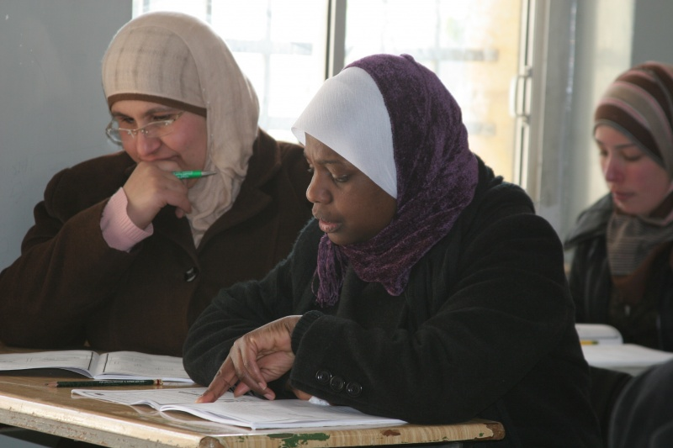
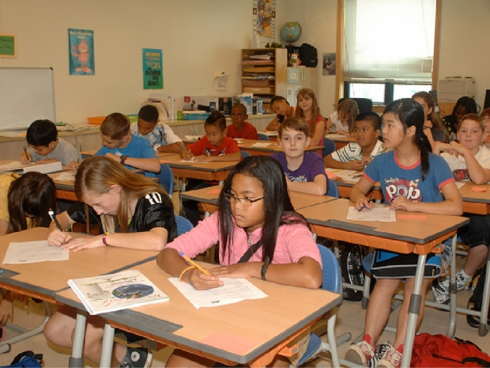
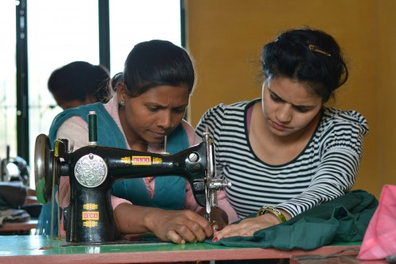
What’s the common feature in the pictures below?
Non-Formal Education
Education
Formal Education
Informal Education

Slide 3
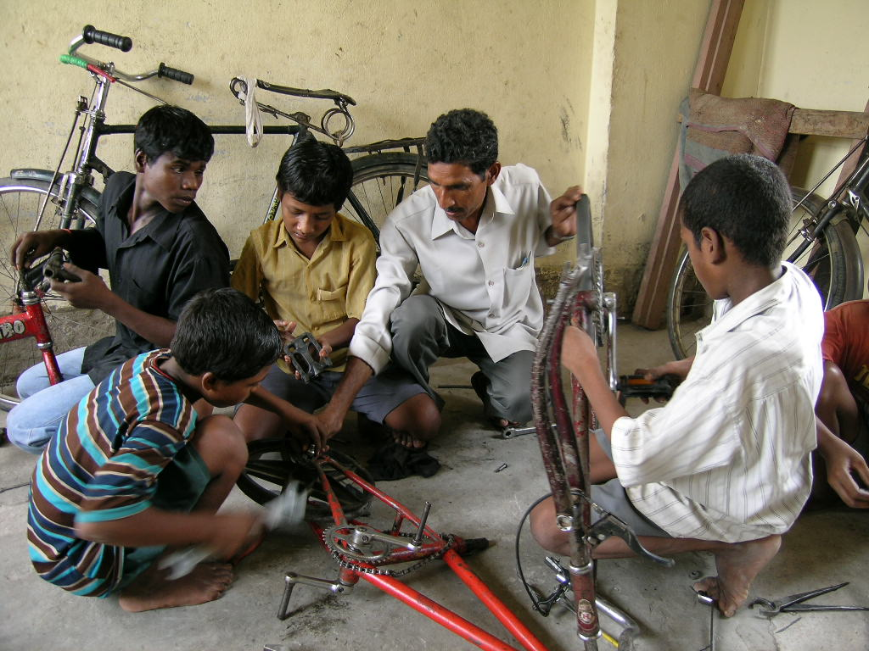
Informal education

Slide 4
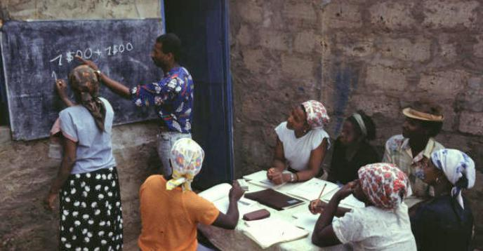
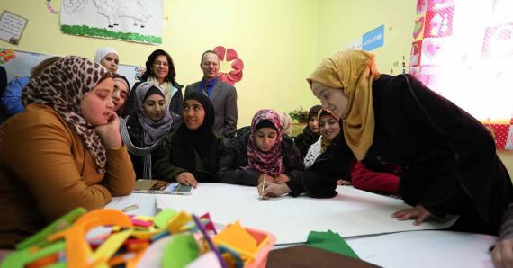
Non-formal Education

Slide 5
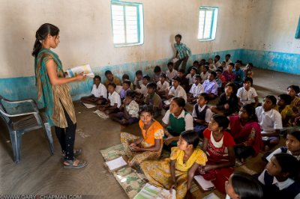
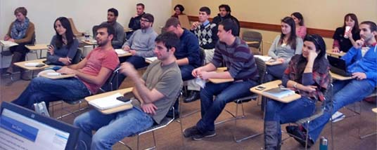
Formal Education

Slide 6
 | Teacher and a class | Exams and Degree | Daily Life
Formal Education
Informal Education
Non-formal Education
Formal Education - Informal Education - Non-formal Education
Term | Definition
1- | Learning through a programme, but the learner doesn’t take exams or get a degree
2- | Learning in a school or a center where the student gets degree and takes exams.
3- | Learning from life experiences, daily work, family, free time activities ( TV / reading / … )
Non-formal Education
Formal Education
Informal Education

Slide 7
Unit 1
Formal, Informal and Non-formal Education
Unit1 Glossary
Primary school
Lecture
There are 3 distinct levels of education in Morocco. Primary school, ______________school and high school.
schooling is ______________until the age of 16. Which means that students should ______________school until the age of 16.
Many students ______________ school before finishing their baccalaureate degree.
A ______________is a student who leaves school before finishing a degree.
After middle school, students go to __________school
Students usually have about 7 ______________a day. They study about 11 ______________
The school year is divided into 2 ______________.
In English, students must ______________a number of quizzes and a global test.
He was expelled from school because of his bad behaviour.
A:What ______________are you in?
B: I am in the ninth grade.
Middle school
Middle
Takes notes
High school
compulsory
Revise
University
compulsory
Faculty
/college
attend
Attend
leave
Class
Evening Classes
dropout
Grade
Literate
dropout
School Subject
Illiterate
high
Term
literacy
classes
Graduate
illiteracy
subjects
Degree / Certificate
terms
Schooling
Take exams
take
Pass exams
Fail exams
Marks / Grades
grade
BA degree (university)
BSc degree

